Slide 1
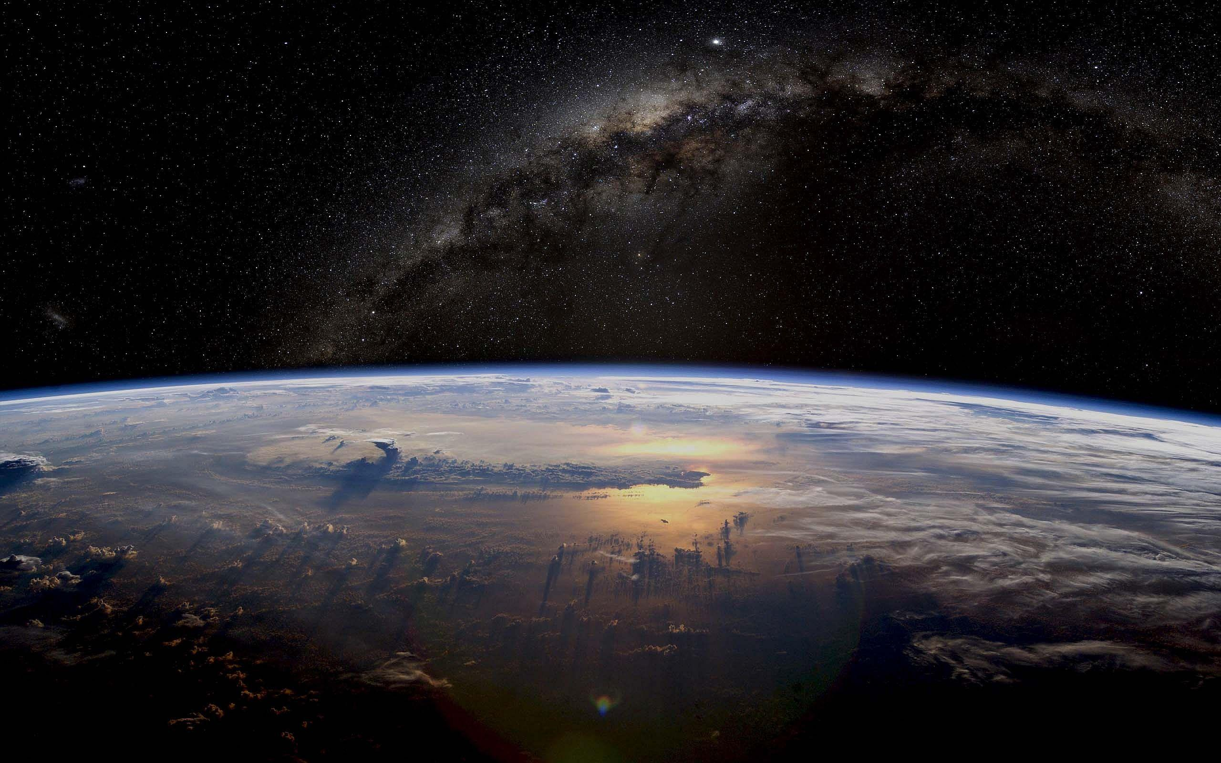



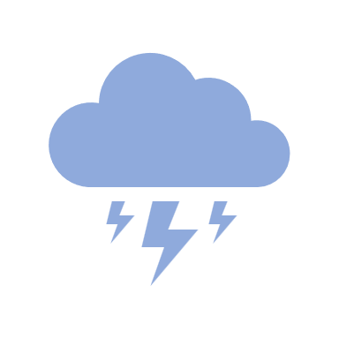
Weather App
2115000939 - Shashank Mishra
2115000905 - Samridhi Singh
2115001005 - Srishty Rai
2115000586 - Lakshya Vashishtha
Guided By: Mr. Farhan

Slide 2

Agenda
Motivation
Functionality
Tools & Languages
Modules
Future Scope

Slide 3
No one can imagine how the weather is going to be on a subsequent day.
The Weather forecast is a big thing that enabled many of us to stay notified about the changes in climatic conditions beforehand. It can be said that it is one of the greatest advancements of all time, mothered by innovative technologies and creative thoughts.
Having an up-to-date information about the weather helps us to take well-read decisions. These weather apps constantly update the forecasts for a day or hour or sometimes for even a minute.
These can be simply termed as the compact weather devices, as they do not only tell about the temperature of that specific region; instead, they can describe the accurate time of the sunrise and sunset, the time of the rainfall, humidity levels, etc.
MOTIVATION

Slide 4

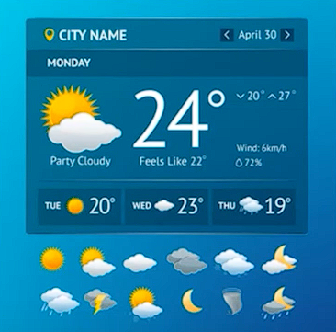
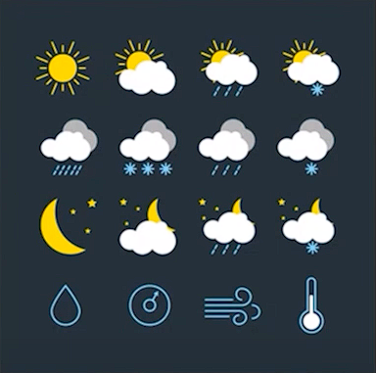
Functionality

Slide 5



Tools & Languages

Slide 6
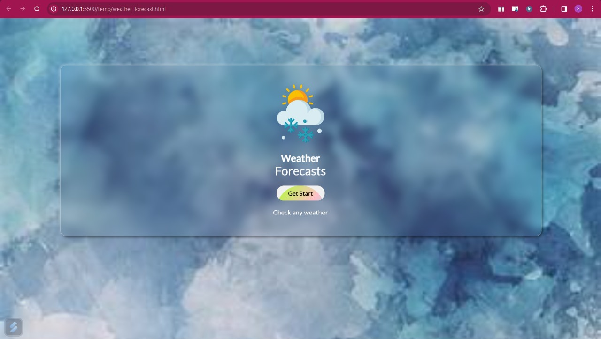

Slide 7
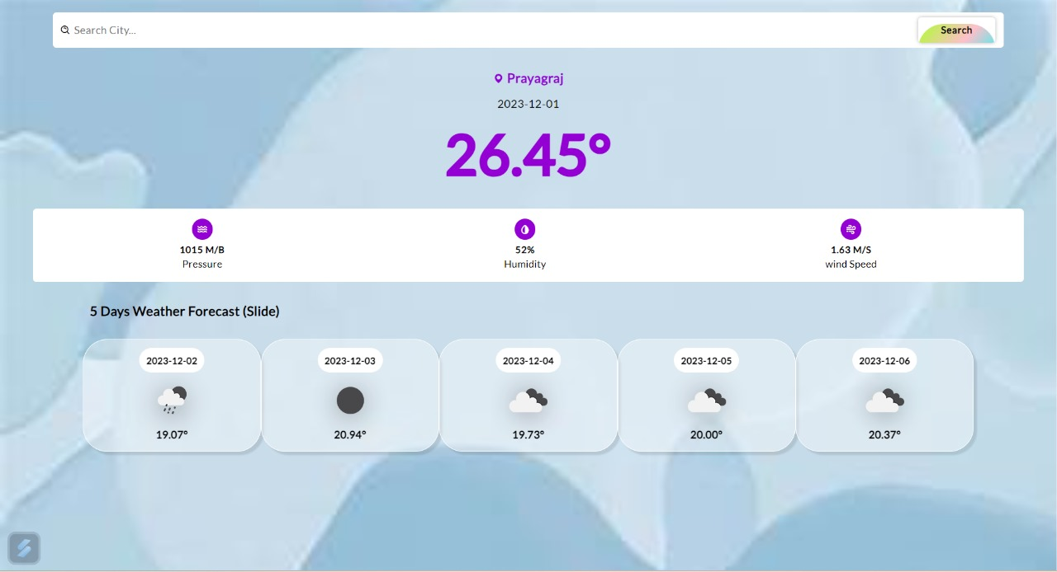

Slide 8
Methodology
Our project is organized using HTML as main frontend language.
User interface is made simple to understand and user-friendly using CSS.
JavaScript is as the backend language to react to the user’s command. The software uses fetch API to retrieve weather data in real time.

Slide 9
Modules
HTML and CSS Design Layout.
User Input Control (Text Field) and User Location Search.
API Development (Weather API)

Slide 10
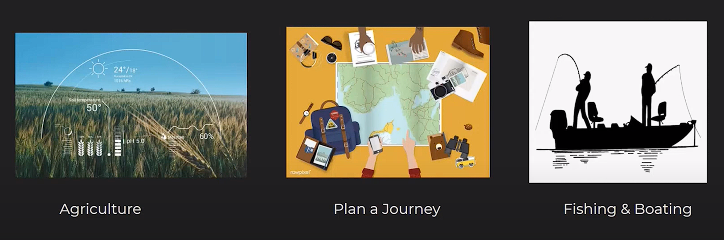
Future Scope
&Many More

Slide 11


